Slide 1

AI/DS – 1 Sem V : 2026 Batch
EventSpark
Virtual Event Platform
The Virtual Event Platform is a comprehensive solution designed to facilitate seamless online events and conferences. It offers a range of features to ensure a engaging and immersive experience for organizers and attendees alike.
B. Yuva Satya Kunaal - 160122771031
YSK
Sasi Vakul Rithwik - 160122771059
SVR
V. Shiva Prasad - 160122771063
VSP

Slide 2
Introduction
Comprehensive Solution
Engaging Experience
Streamlined Workflows
The platform provides a central hub for managing all aspects of virtual events, from event creation to participant engagement.
Leveraging interactive tools and multimedia capabilities, the platform creates a dynamic and immersive environment for attendees.
Intuitive features and automation streamline event logistics, allowing organizers to focus on delivering a successful event.

Slide 3
Abstract
Create a responsive virtual event platform for managing and participating in events online.
Platform will be compatible across devices, offering a seamless experience.
Supports different user roles: administrators, event organizers, and attendees.
Administrators can oversee the platform, manage users, and ensure smooth operations.
Event organizers can create events, invite participants, and share details like Google Meet links.
Attendees will have an intuitive interface to join events, interact, and give feedback.

Slide 4
Abstract (cont.)
Technologies: HTML, CSS, JavaScript, Node.js, Express, and MongoDB.
Focus on scalability, security, and responsiveness for a robust platform.
User-friendly design to minimize technical difficulties for all users.
Global event support with features like user authentication and personalized dashboards.
Event creation and management tools included for a streamlined experience.
Feedback mechanisms to enhance user engagement and improve platform quality.

Slide 5

Modules Used
1
nodemon
2
mongoose
Automatically restarts the server when changes are made to the code, enabling faster development.
Provides a robust object data modeling (ODM) layer for interacting with a MongoDB database.
3
jsonwebtoken
4
express, dotenv, cors, body-parser, bcrypt
Generates and verifies JSON Web Tokens (JWT) for secure user authentication and authorization.
These modules handle server-side routing, environment variables, cross-origin resource sharing, data parsing, and password hashing.

Slide 6
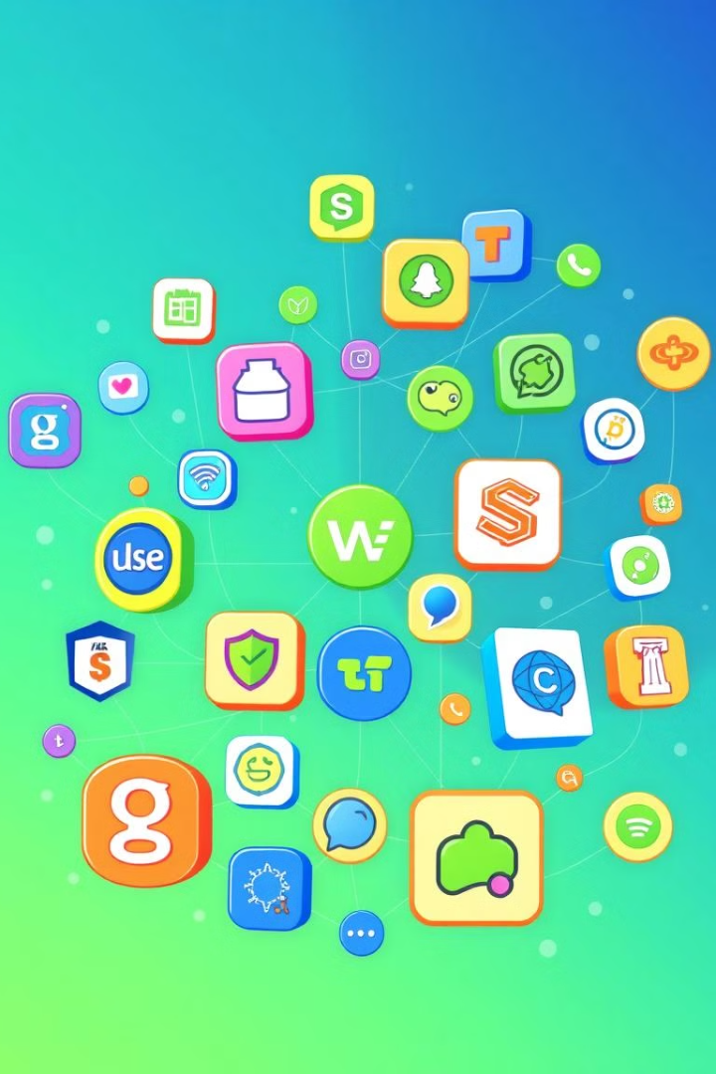




Web Development Languages and Frameworks
HTML
CSS
The standard markup language for creating web pages and applications.
Responsible for styling the visual appearance of web pages.
JavaScript
Express
The programming language that adds interactivity and dynamic behavior to web pages.
A minimal and flexible Node.js web application framework for building server-side applications.

Slide 7

Advantages of the Website
Increased Reach
Cost Savings
Virtual events can attract a global audience, expanding the potential number of attendees.
Eliminating the need for physical venue, travel, and accommodation expenses reduces overall event costs.
Enhanced Engagement
Scalability
Interactive features and personalized experiences keep attendees engaged throughout the event.
The platform can easily accommodate growing event size and audience without logistical challenges.

Slide 8
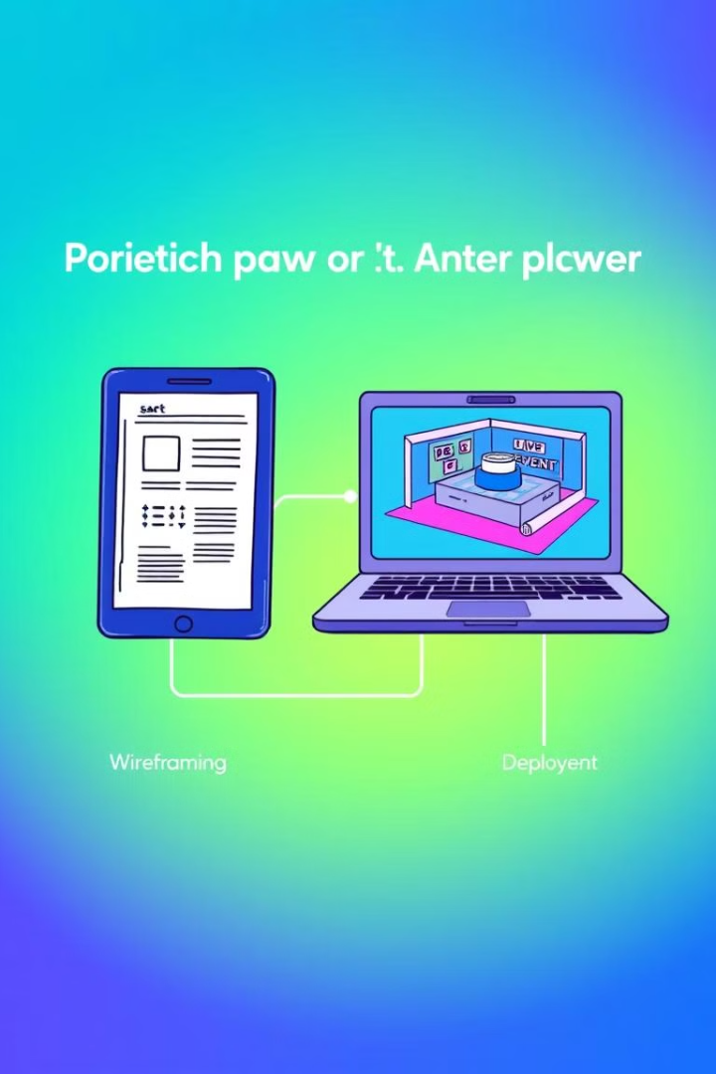
Workflow
1
Wireframing
Creating low-fidelity sketches to plan the layout and structure of the platform.
2
Prototyping
Developing interactive mockups to test and refine the user experience.
3
Visual Design
Crafting the visual identity and branding elements for a polished, cohesive appearance.

Slide 9
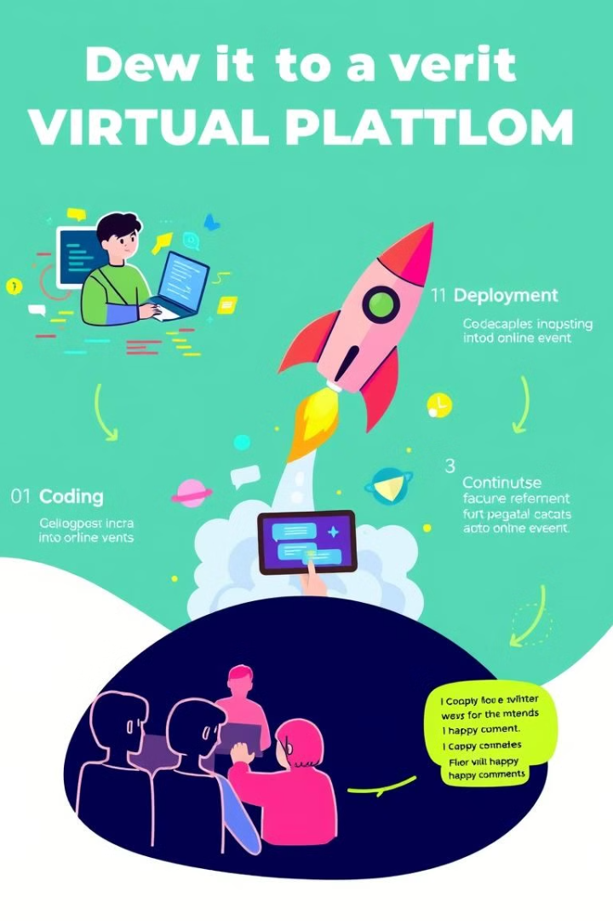
Workflow (cont.)
4
Coding
Implementing the platform's functionality using HTML, CSS, JavaScript, and backend technologies.
5
Deployment
Launching the platform and ensuring a smooth, reliable, and scalable user experience.
6
Iterative Feedback Loops
Continuously gathering user feedback and implementing improvements to enhance the platform.

Slide 10
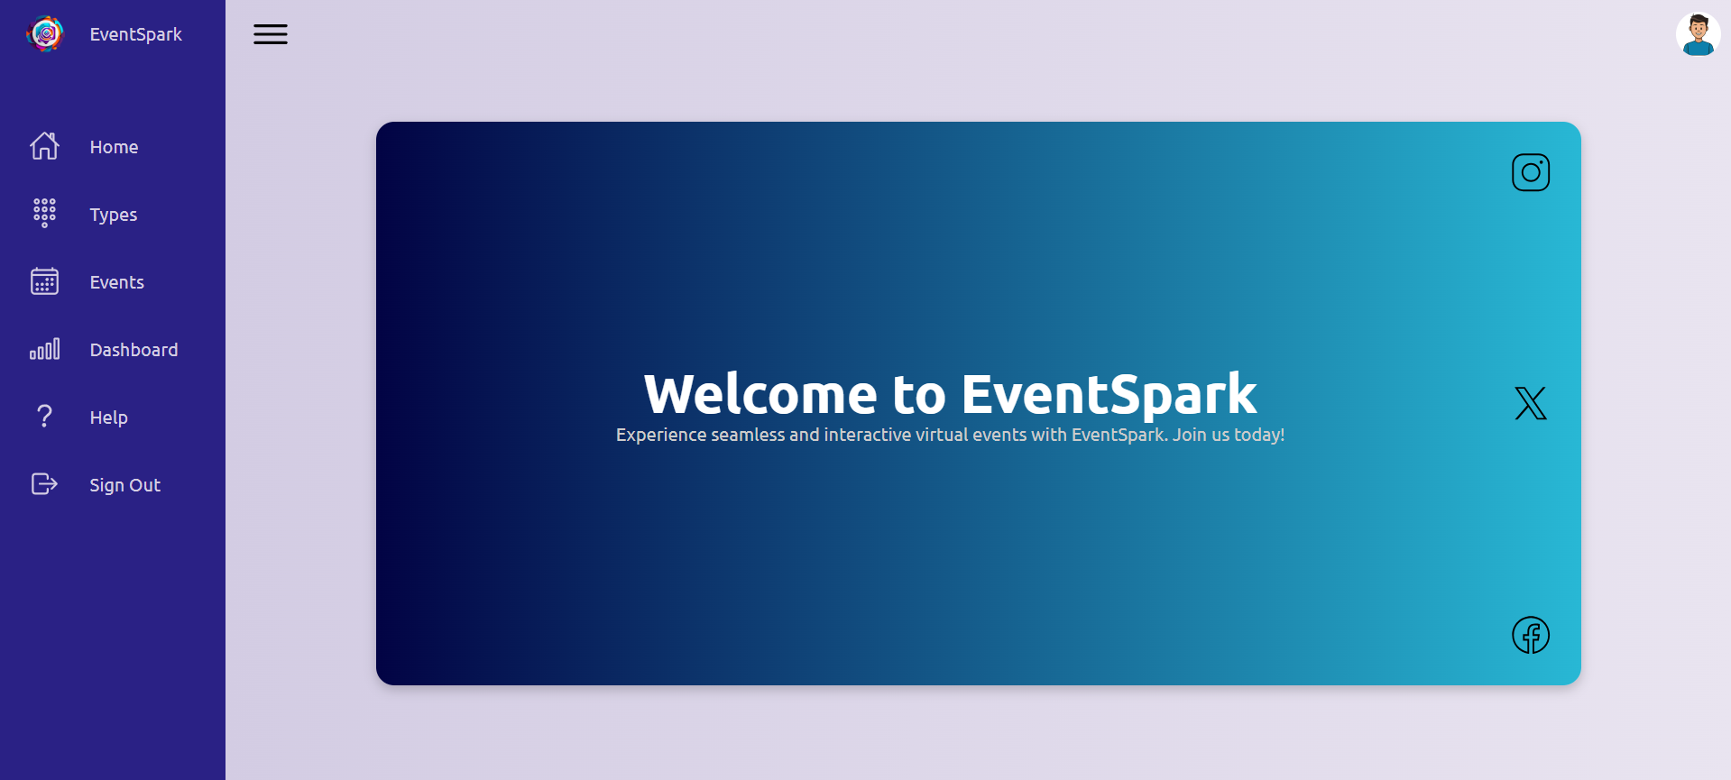


Event Creation
Agenda
The platform allows for the creation of a detailed event agenda with speakers, sessions, and schedules.
Attendee Management
Organizers can easily register, manage, and engage with attendees through the platform.

Slide 11
Participant Engagement
Live Interactions
Networking Opportunities
Personalized Experiences
Attendees can actively participate in the event through features like live chat, Q&A, and polls.
Virtual breakout rooms and one-on-one video calls facilitate meaningful connections between attendees.
The platform can deliver tailored content and recommendations based on attendee preferences and behaviors.

Slide 12

Conclusion
The Virtual Event Platform provides a comprehensive and versatile solution for organizers to host engaging, interactive, and impactful online events. By leveraging cutting-edge technologies and user-centric design, the platform offers a seamless and immersive experience for both organizers and attendees.

